Slide 1
Starshade Data Challenge
Approach and Release 1 Results
Brian Dunne
brian.dunne@quartus.com
4/7/2021

Slide 2
Proposed approach
The proposed approach includes three high level steps:
  Background estimation and removal.
  Transformation of the multi-spectral foreground image pixels into a feature space based on matched filtering.
  Perform Bayesian inference on the feature space to produce a likelihood ratio which can be thresholded for planet detection.
The initial focus is on background estimation and removal, since backgrounds must be successfully estimated and removed before later steps in the pipeline can be used. Initial findings during the background estimation development may also lead to revised ideas for the later steps.

Slide 3
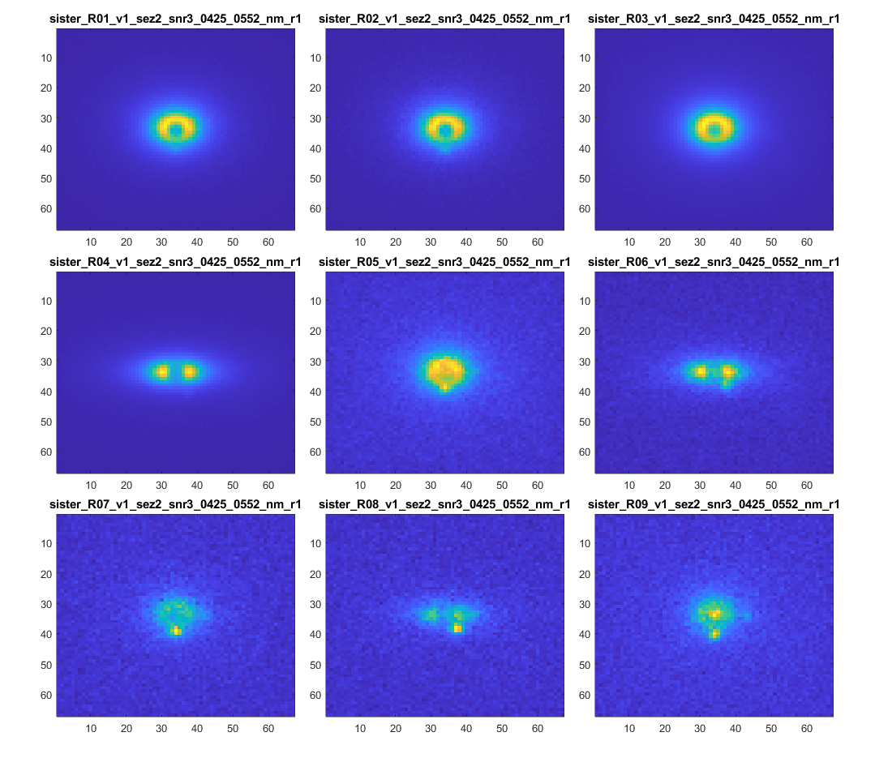
Release 1 Data Observations
A visualization of all the SNR3 cases is shown for reference.
All exozodiacal disks appear to be symmetric with a smooth intensity roll-off. This was also stated in the data release notes.
The most notable variability comes from:
  Relative intensity of the disk
  Inclination and orientation
  Decenters between exozodiacal disk, starshade center, and image center.

Slide 4
Background estimation Approach
The first step in the process is to estimate backgrounds in the release 1 data. After visualizing the data it seems clear that exozodiacal disks are the strongest background source and should be prioritized for estimation and removal.
Because the disks seem smooth and radially symmetric within an orbital plane, a parametric model seems appropriate.
Two general approaches can be taken towards constructing a parametric model:
  First principals approach: In this approach a parametric model would be constructed according to theory which describes the structure of a disk and how it scatters light. For example the mass distribution may be described by a hydrostatic equilibrium, with some model of how light is scattered by the dust and rolls off with distance from the star. It seems like a lot of prior research exists on this topic.
  Empirical approach: In this approach a parametric model would be constructed simply to match the image data as it appears, independently of physical theory. For example the disks appear to have a certain radial symmetry in a given plane, and have 1D function which describes the intensity vs radial distance from the center.
The empirical approach is taken initially, i.e. a parametric model is constructed simply through inspection of the data and iterating on quality of fit via a guess and check process.

Slide 5
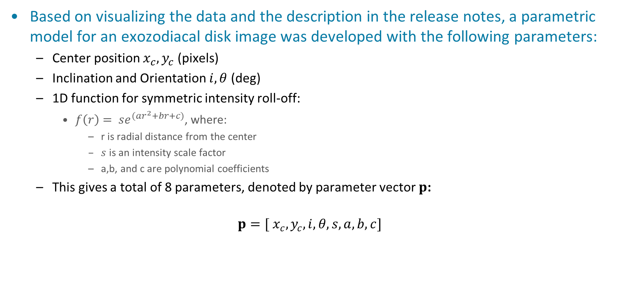
Exozodiacal disk parametric model
Based on visualizing the data and the description in the release notes, a parametric model for an exozodiacal disk image was developed with the following parameters:
  Center position $x_{c},y_{c}$ (pixels)
  Inclination and Orientation $i,θ$ (deg)
  1D function for symmetric intensity roll-off:
    $f\left(r\right)= se^{(ar^{2}+br+c)}$, where:
      r is radial distance from the center
      $s$ is an intensity scale factor
      a,b, and c are polynomial coefficients
  This gives a total of 8 parameters, denoted by parameter vector $p$:
  $$p=[ x_{c},y_{c},i,θ,s,a,b,c]$$

Slide 6
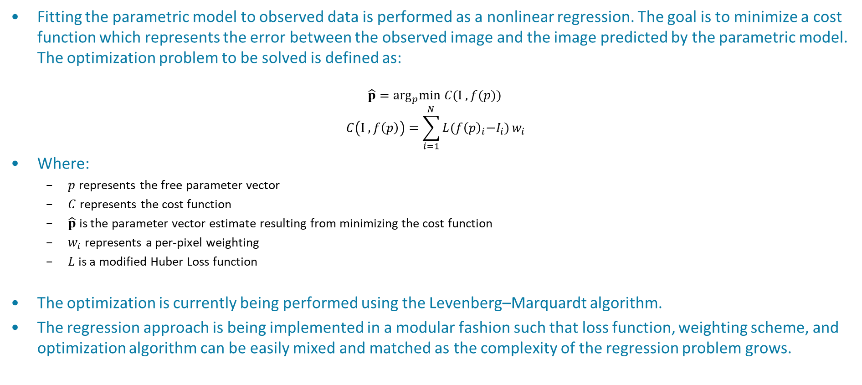
Exozodiacal disk parametric model
Fitting the parametric model to observed data is performed as a nonlinear regression. The goal is to minimize a cost function which represents the error between the observed image and the image predicted by the parametric model. The optimization problem to be solved is defined as:
$$\hat{p}=\arg_{p}min C(I , f(p))$$
$$C\left(I , f\left(p\right)\right)=\sum_{i=1}^{N}{L{(f\left(p\right)}_{i}−I_{i})}w_{i}$$
Where:
  $p$ represents the free parameter vector
  $C$ represents the cost function
  $\hat{p}$ is the parameter vector estimate resulting from minimizing the cost function
  $w_{i}$ represents a per-pixel weighting
  $L$ is a modified Huber Loss function
The optimization is currently being performed using the Levenberg–Marquardt algorithm.
The regression approach is being implemented in a modular fashion such that loss function, weighting scheme, and optimization algorithm can be easily mixed and matched as the complexity of the regression problem grows.

Slide 7
Background estimation Approach
Solving the regression problem requires some consideration of handling unmodeled effects. Since the current approach only attempts to model the exozodiacal disk, the regression may perform poorly to the presence of unmodeled effects. The three most significant unmodeled effects in the images appear to be:
  Occulter transmission, star flux, or any other fast-decaying effects near the starshade center.
  A baseline background intensity level.(i.e. dark noise)
  Exoplanets.
Regarding 1. Occulter transmission and other fast-decaying effects which are significant near the starshade center, but decay quickly with radial distance: An initial attempt was made to add those effects to the parametric model, but results were not so great. The quick and easy solution was to use the weighting scheme in the regression to set pixel weights to zero in a region around the starshade center. This is shown in the results as a masked region in the image.
Regarding 2. Simply subtracting the median intensity from the image gave decent results and allowed the parametric model of the disk intensity to roll off to zero.
Regarding 3. The chosen loss function, which is a modified Huber loss function, can be tuned to handle the exoplanets as outliers. The regression method attempts to be robust against outliers, and therefore does not consider the planets heavily in the cost. This can be improved further with a two-pass regression where pixels with large errors in the first pass are rejected as outliers and the regression is solved again excluding those pixels.

Slide 8
Initial Results
Rather than showing results for all 30 cases, a few examples are shown that are categorized as: good, mixed, or bad.
‘Good’ results are categorized by a residual which is dominated by noise and/or exoplanets. I.e. the model has successfully accounted for a large majority of the image content attributable to the disk.
‘Mixed’ results are categorized by a residual where background is highly attenuated, but the residual has some significant structure or bias that is an artifact of the background subtraction.
‘Bad’ results are categorized by a residual which still contains significant disk structures with intensity that is dominant over exoplanet signals.

Slide 9
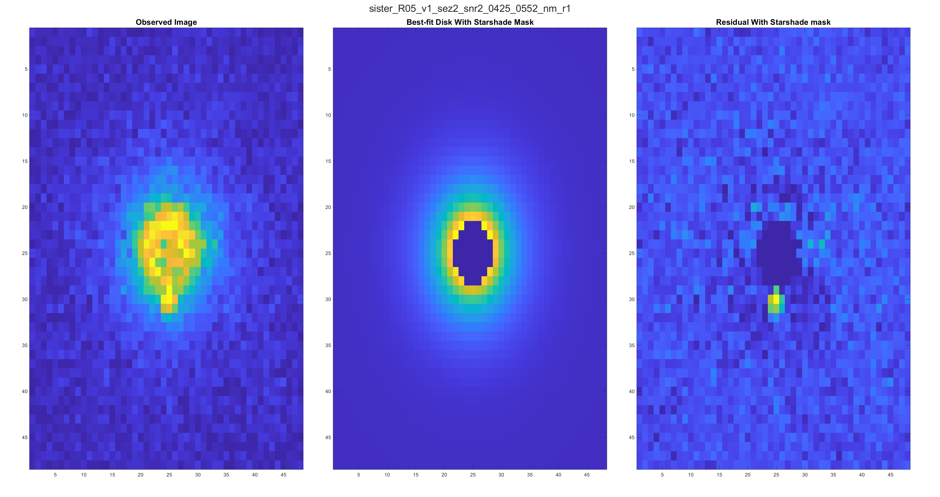
Good results

Slide 10
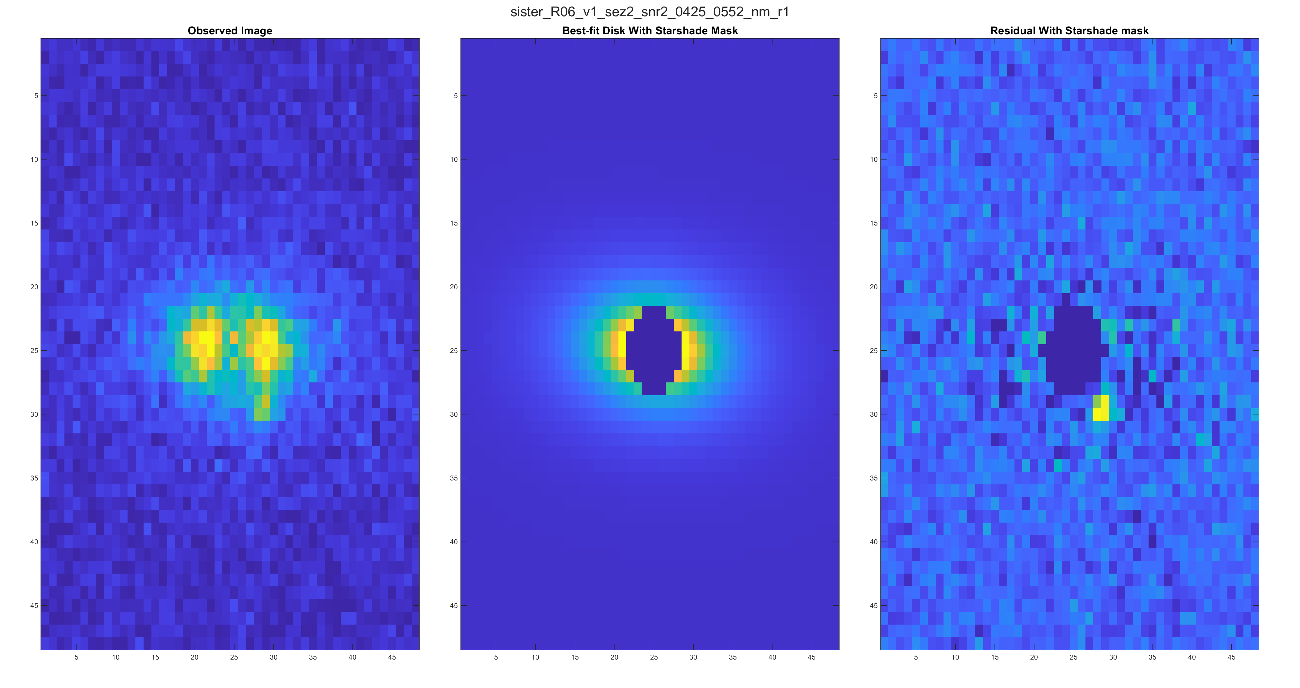
Good results

Slide 11
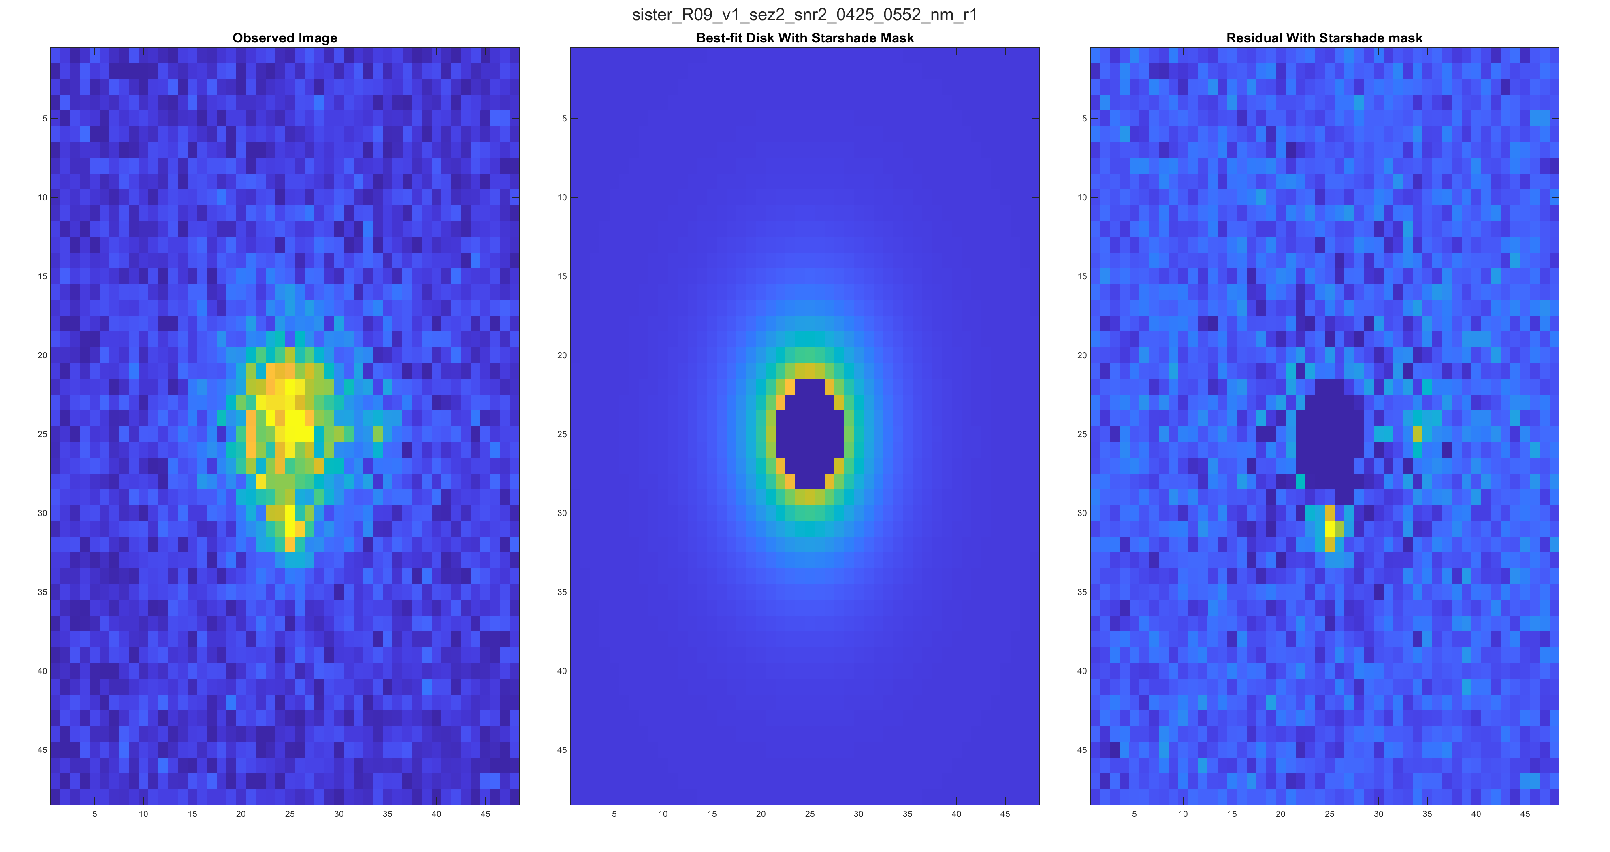
Good Results

Slide 12
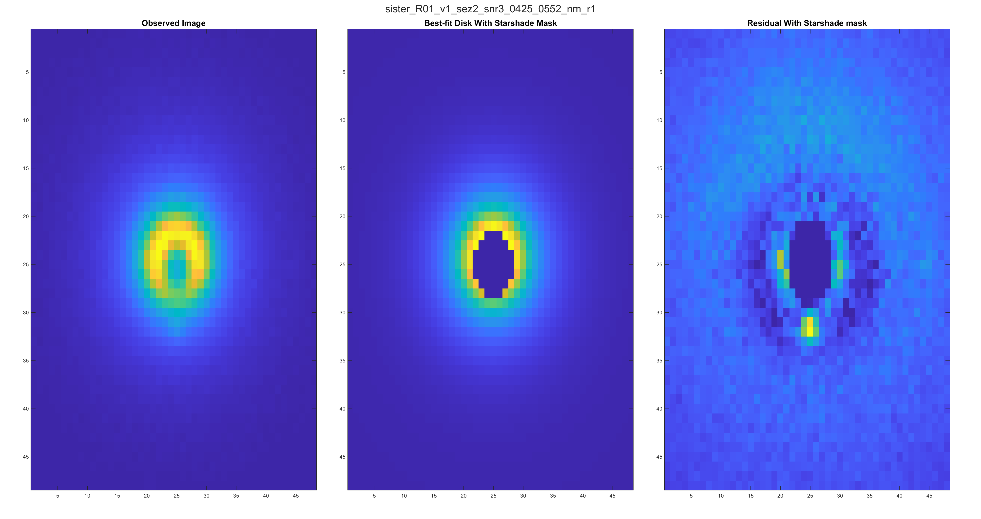
Mixed Results

Slide 13
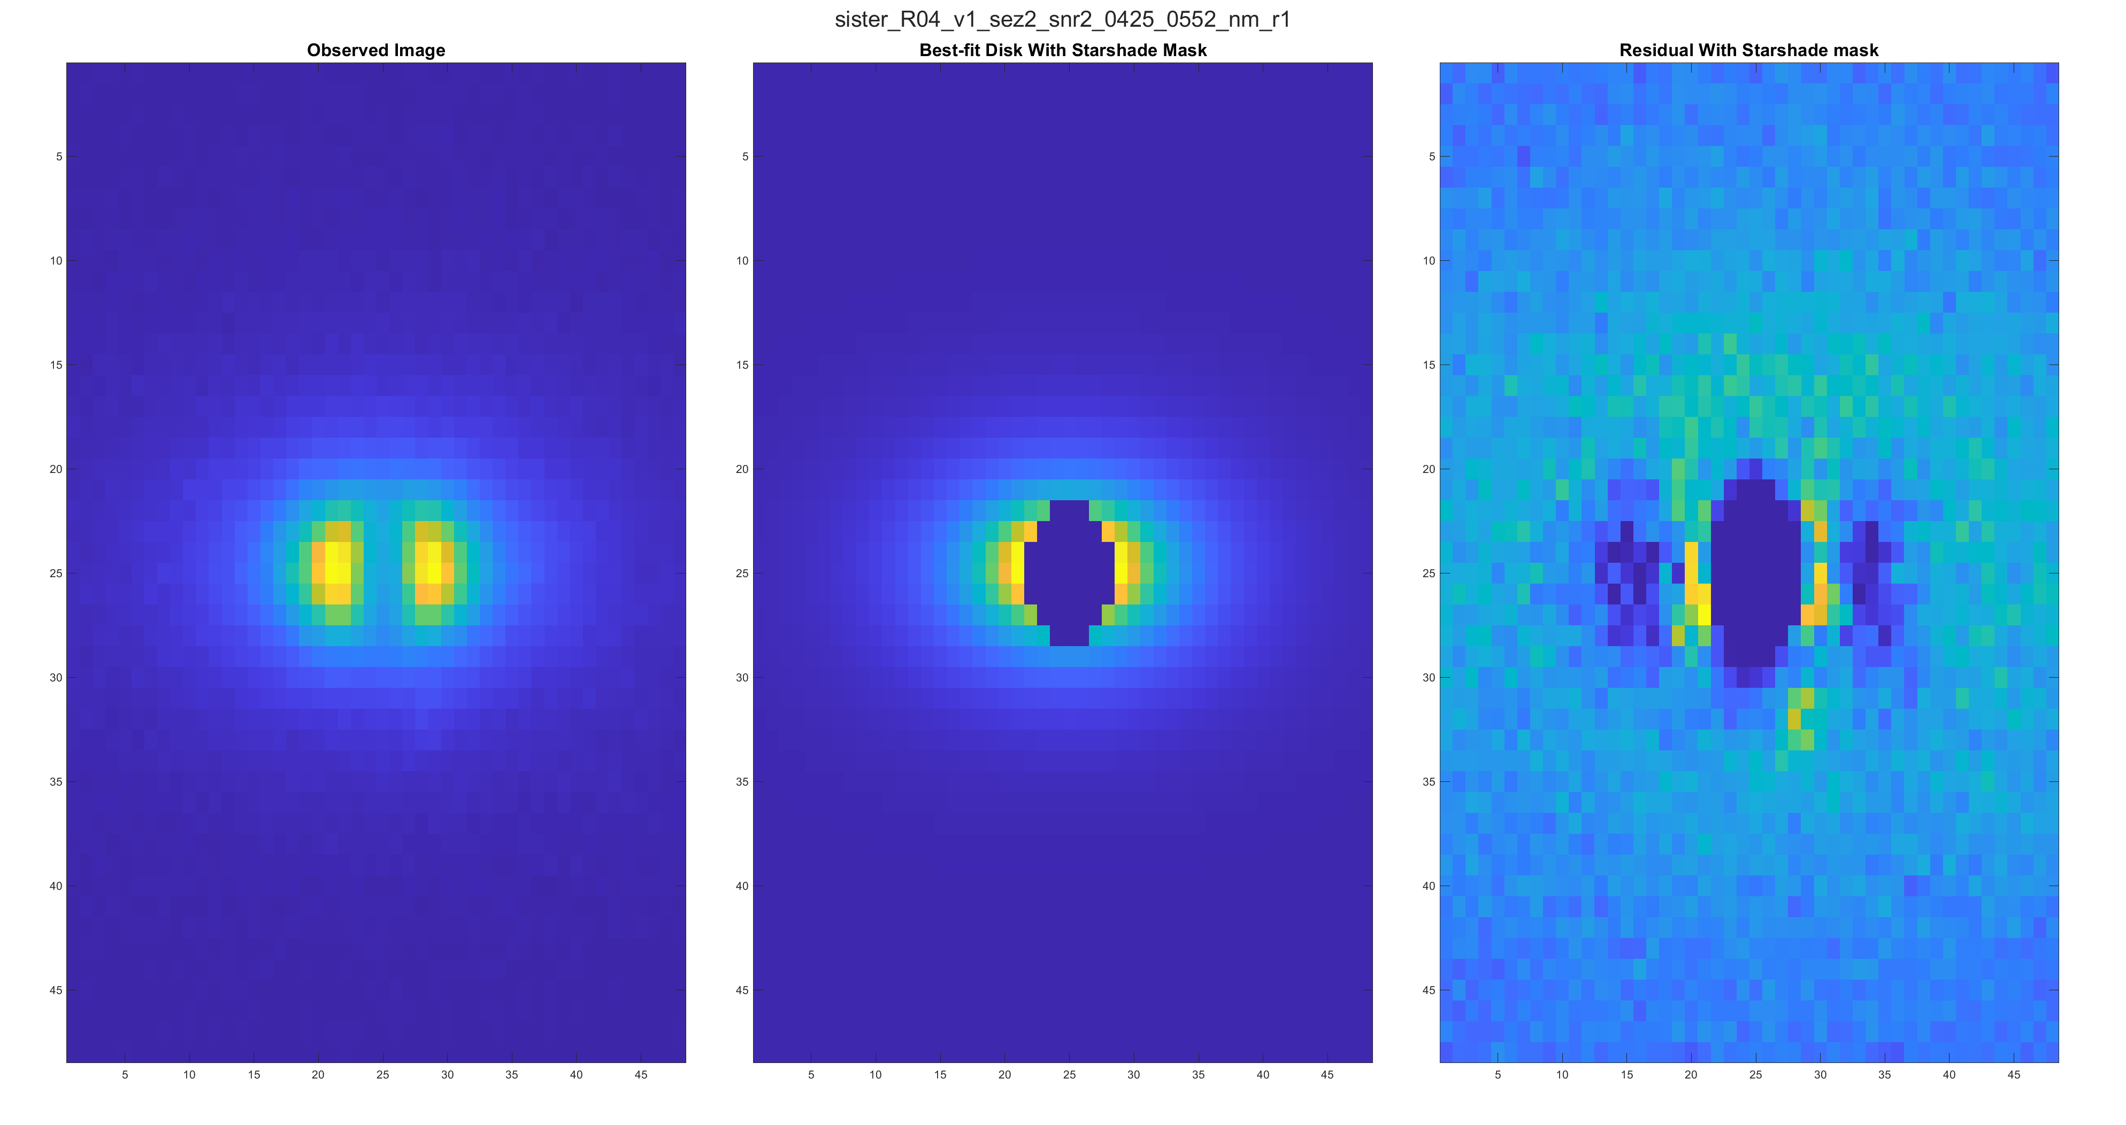
Mixed Results

Slide 14
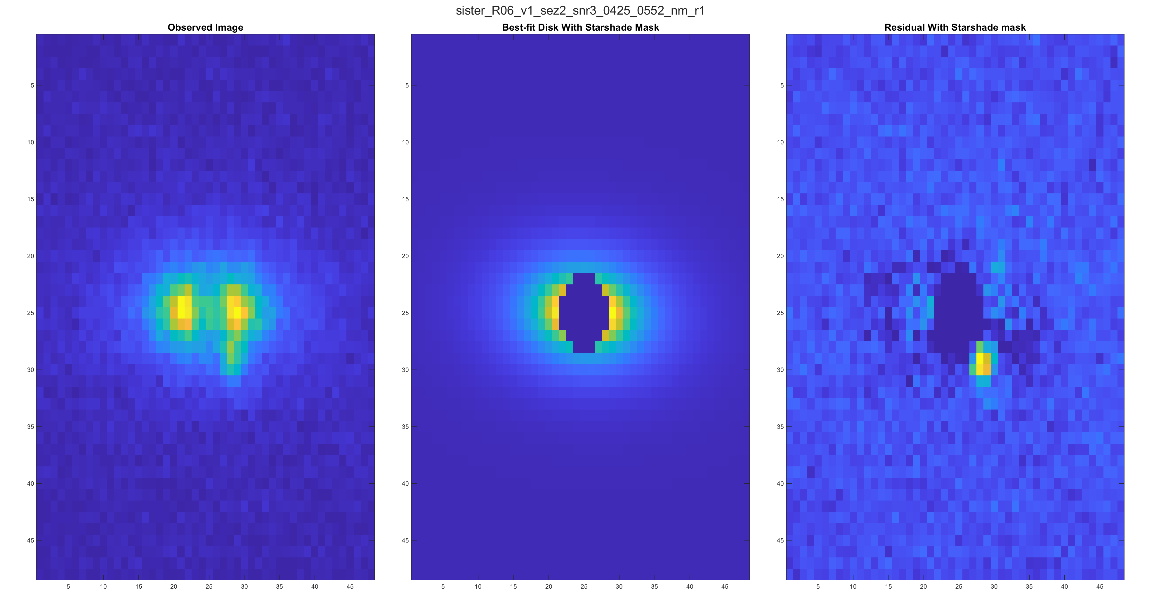
Mixed Results

Slide 15
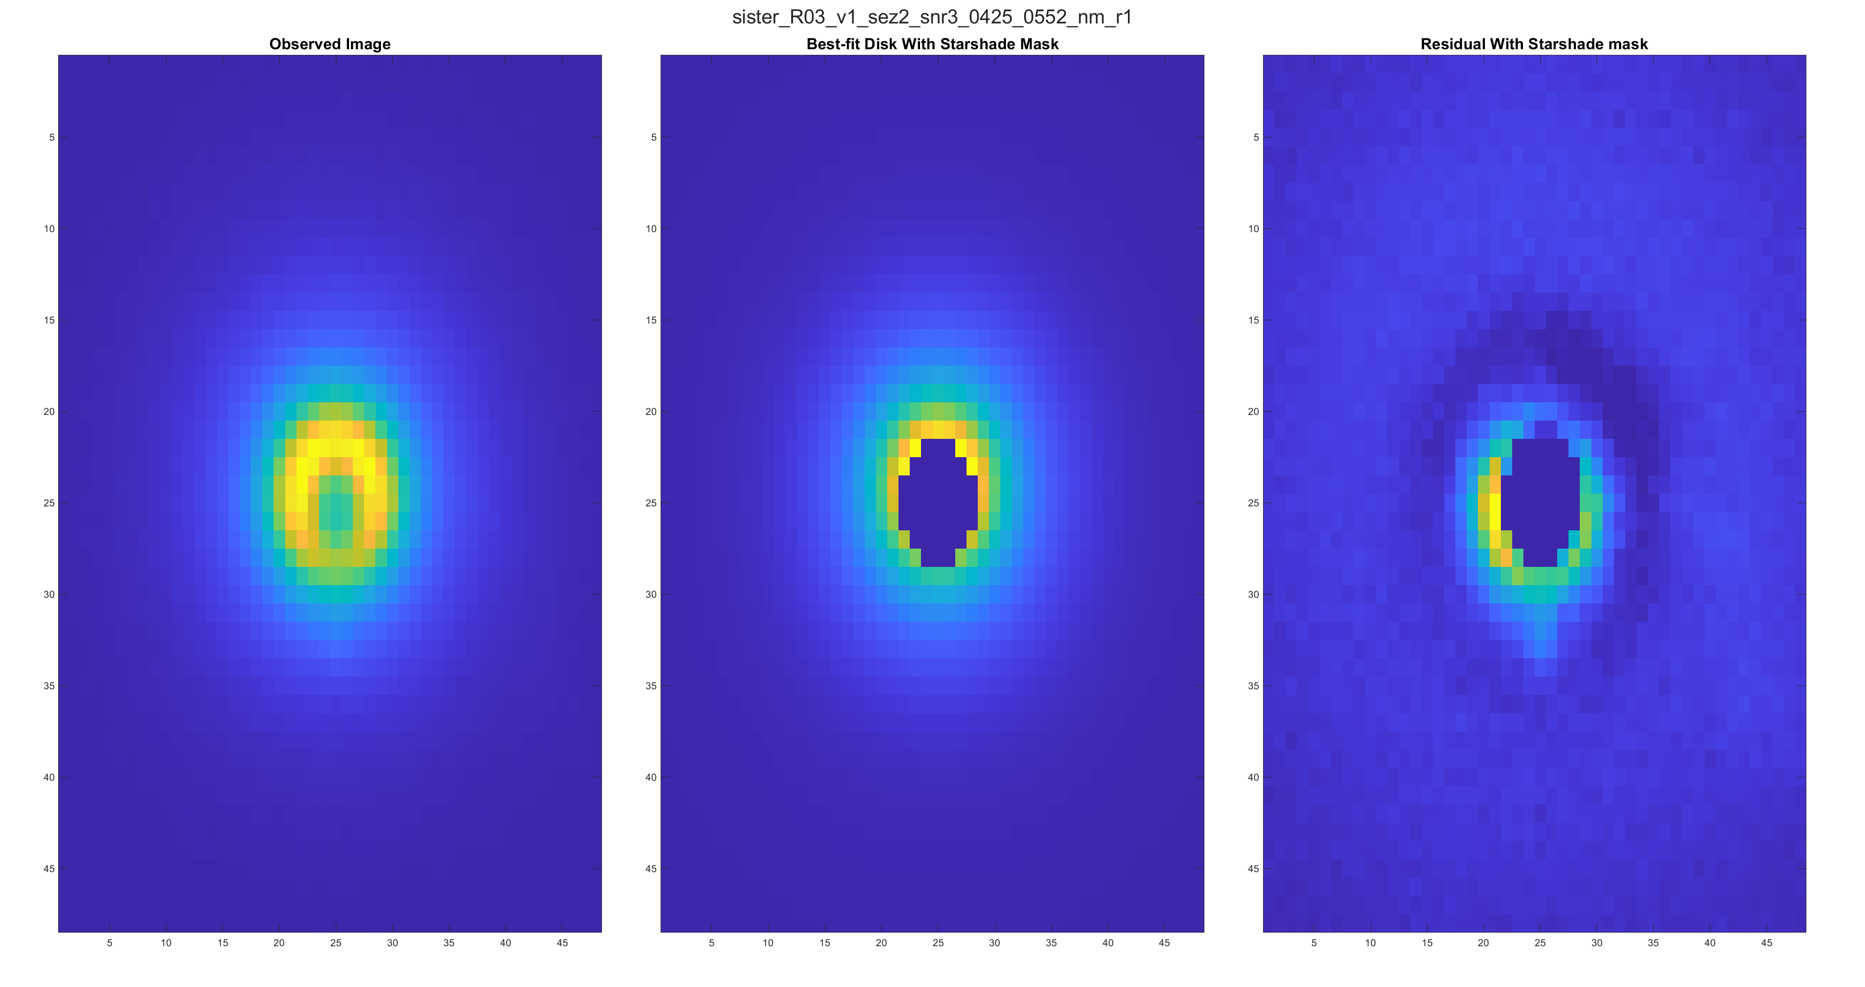
Bad Result

Slide 16
Next Steps
Investigate variability in results across the scenarios for the current approach.
  Unmodeled effects. It seems likely that a big part of the residuals in the ‘Mixed Results’ examples are attributable to unmodeled effects near the center of the starshade which do not roll off quickly enough to be neglected. This could include occulter transmission, star effects, or solar glint. These effects may exist even in the ‘good’ cases with the main difference being relative exoplanet intensity. These case could be handled better either with additional model parameters or an adjusted loss/weighting scheme.
  Optimization failures. It seems like at least in the ‘Bad result’ scenario the optimizer failed to find the global minimum. It’s not totally obvious that the regression problem is convex or well conditioned, or if it is whether it will remain so as more parameters are added to the models.
Estimate more of the target parameters
  Exozodiacal disk parameters are being estimated in some sense, but they need to be converted to physical units.
  Isolated exoplanets are clearly visible in the residuals, but additional work needs to be done to detect them and estimate their parameters.(i.e. using a matched filtering approach.)
Investigate benefits of multispectral data when it is available
  Multispectral images will likely give big advantages for separating components of the image and estimating parameters. For example various components will have different spectral characteristics which will provide big advantages for separating background and foreground components.

Slide 17
References and Relevant Links
References
Rafels, S. H., Shaklan, S. B., Turnbull, M. C., & Cady, E. J. (2019). SISTER: Starshade Imaging Simulation Toolkit for Exoplanet Reconnaissance (Conference Presentation). Techniques and Instrumentation for Detection of Exoplanets IX. doi:10.1117/12.2528332
Hastie, T., Friedman, J., &amp; Tisbshirani, R. (2017). The Elements of statistical learning: Data mining, inference, and prediction. New York, New York: Springer
Vio, R., Andreani, P., &amp; Wamsteker, W. (2004). Some good reasons to use matched filters for the detection of point sources in CMB maps. Astronomy &amp; Astrophysics, 414(1), 17-21. doi:10.1051/0004-6361:20031632
Relevant Links
http://sister.caltech.edu/
https://asd.gsfc.nasa.gov/Christopher.Stark/catalog.php
https://en.wikipedia.org/wiki/Robust_statistics
https://www.mathworks.com/matlabcentral/fileexchange/39564-lmfnlsq2

